Slide 1
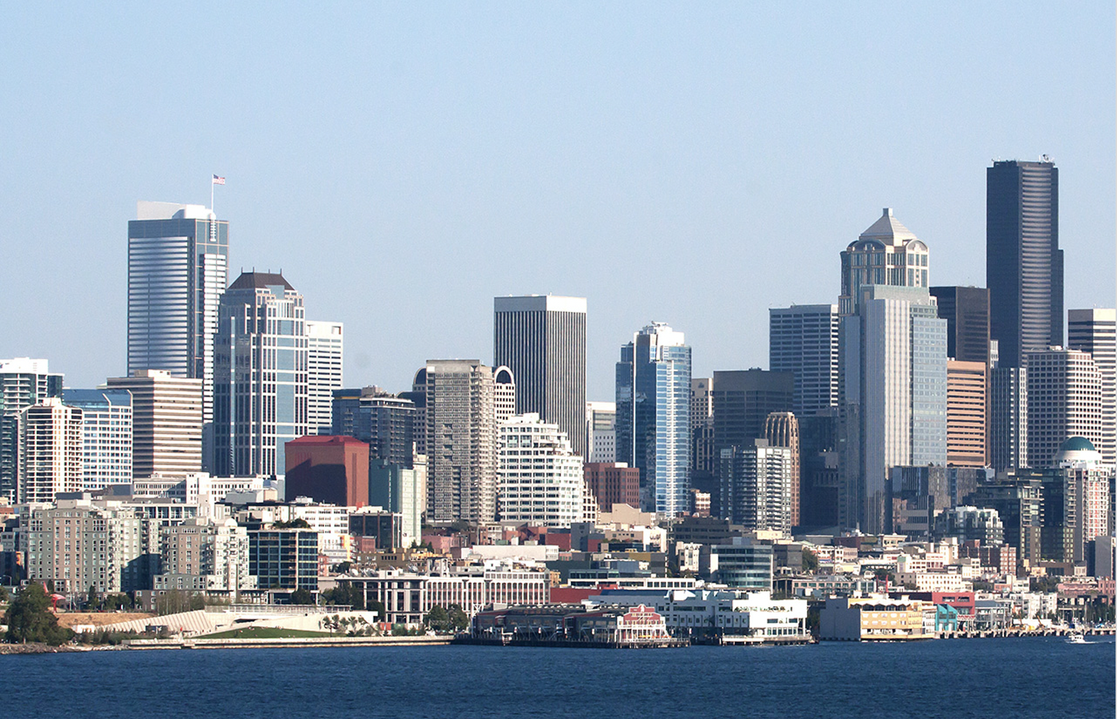
Seattle
Crime Analysis 2008-2020
By Iggy Zhao

Slide 2
Table of Content
01
Introduction
02
Data Overview & Pre-processing
03
Data Exploration & Insights
1
2
3
Crime
Categories
Crime vs.
Districts
Crime in
Downtown
6
5
4
Downtown vs.
Category & Hour
Hourly
Crime
Monthly
Crime
04
Unsupervised Learning
05
Conclusion

Slide 3
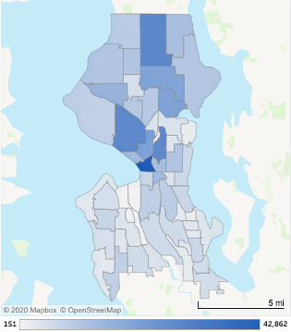
01 Introduction
Vision
Analyze the crime data of Seattle since 2008. Explore the types of crime, time, and region, and attempt to find potential insights to provide safety recommendations for residents
Specific Topics
Explore the crimes of the three major categories and 30 parent categories
Rank the crimes in different regions
Compares the monthly and hourly patterns
Crime in the downtown area vs categories and start time

Slide 4
02 Data Overview
& Pre-processing
01
02
03
04
Dataset Introduction
Data Dictionary
Data Sampling
Missing Data
Crime record for the city of Seattle from January 1st, 2008 to the end of April 2020 with 824220 rows and 17 columns
The data dictionary explained each features in this dataset in details, which can be found in Appendix.
Randomly sampled 5% (41211 rows) from the original dataset, dropped 4 columns: Precinct, Sector, Beat and _c0. Rename the columns.
Dropped Offense End Datetime (19866 missing and useless for analysis), ignored 3.6% missing data of address.

Slide 5
03 Data Exploration
& Insights
1
2
3
Crime
Categories
Crime vs.
Districts
Crime in
Downtown
6
5
4
Downtown vs.
Category & Hour
Hourly
Crime
Monthly
Crime

Slide 6
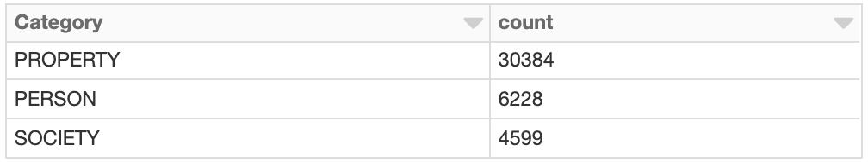
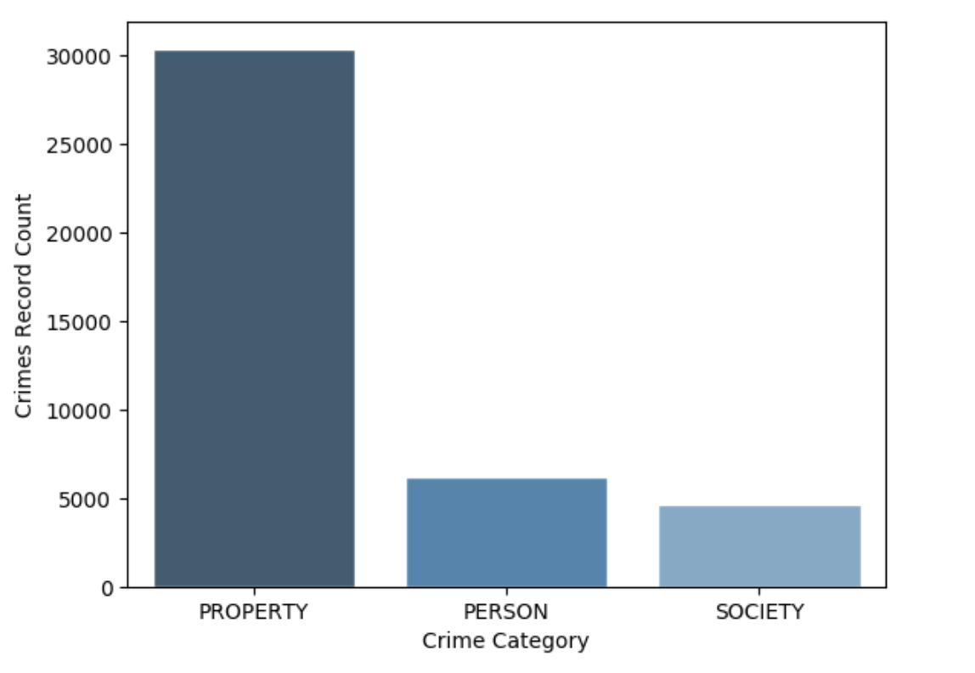
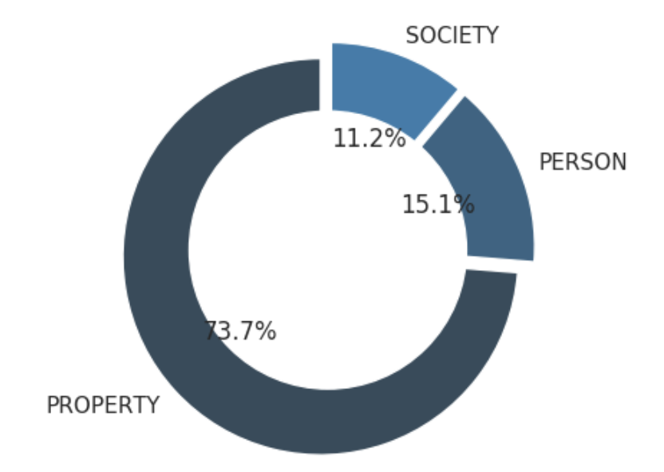
1-1 Crime Main Category
Property (73.7%) > Person (15.1%) > Society (11.2%)

Slide 7
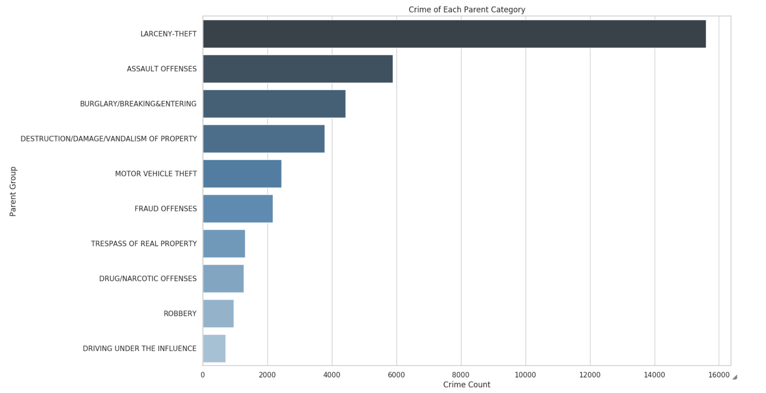
1-2 Crime Parent Group
Among 30 parent groups, Larceny Theft was the most common crime

Slide 8
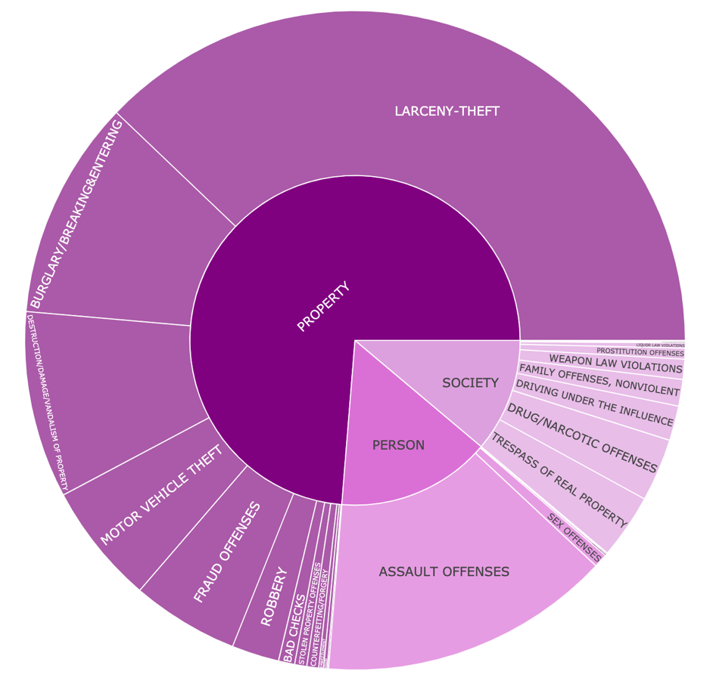
1-3 Two Categories - Sunburst
Bring two levels of categories together to see proportions of each main category and corresponding parent groups

Slide 9
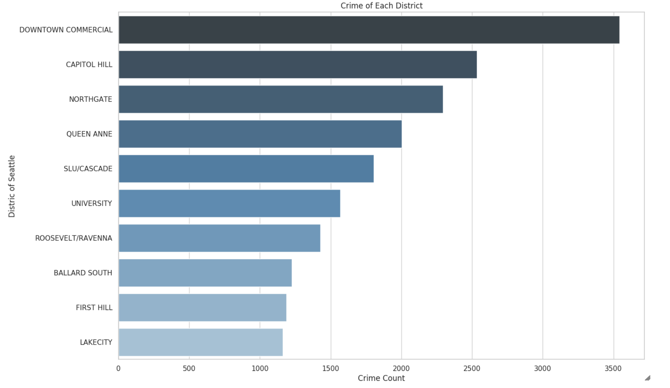
2 Crime vs. Districts
Downtown Commercial is the area with the most cases
- population density in the city center is relatively large and the economy is relatively concentrated

Slide 10
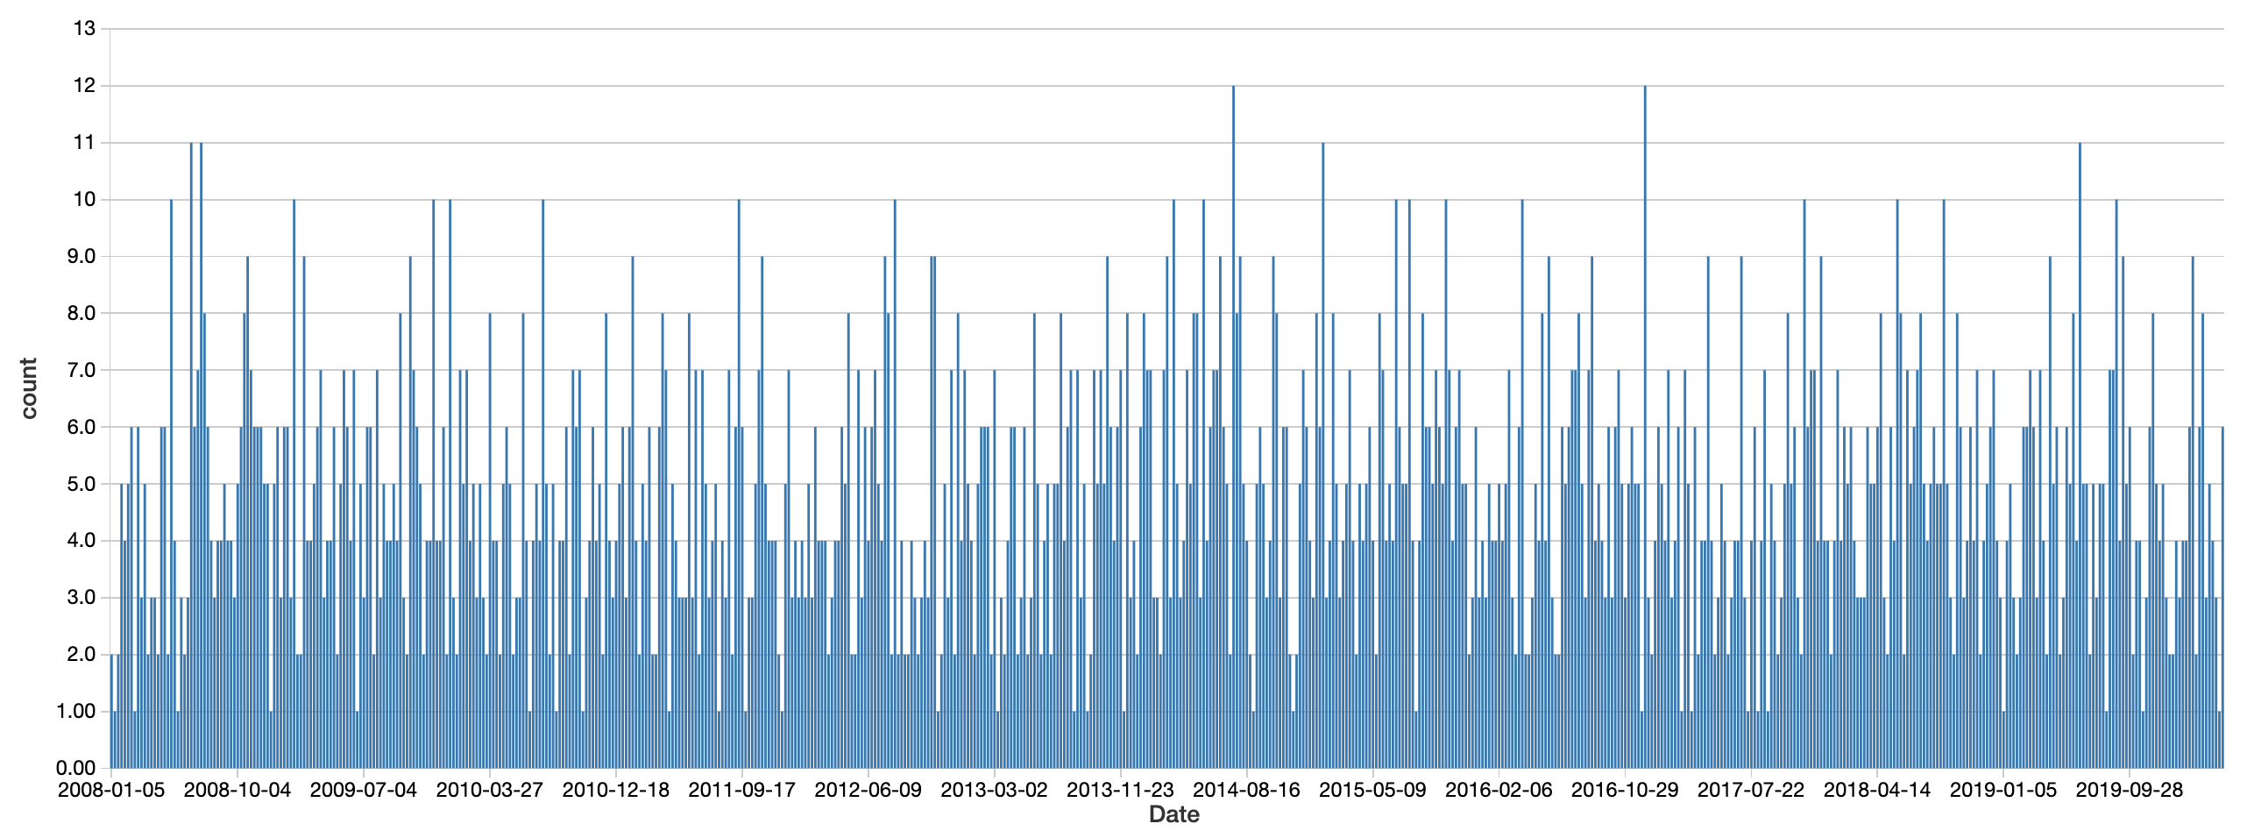
3 Downtown Crimes on Sunday
- Manually ranged downtown
Define the range of downtown within longitude (-122.285167, -122.385167) and latitude (47.558013,47.658013).

Slide 11
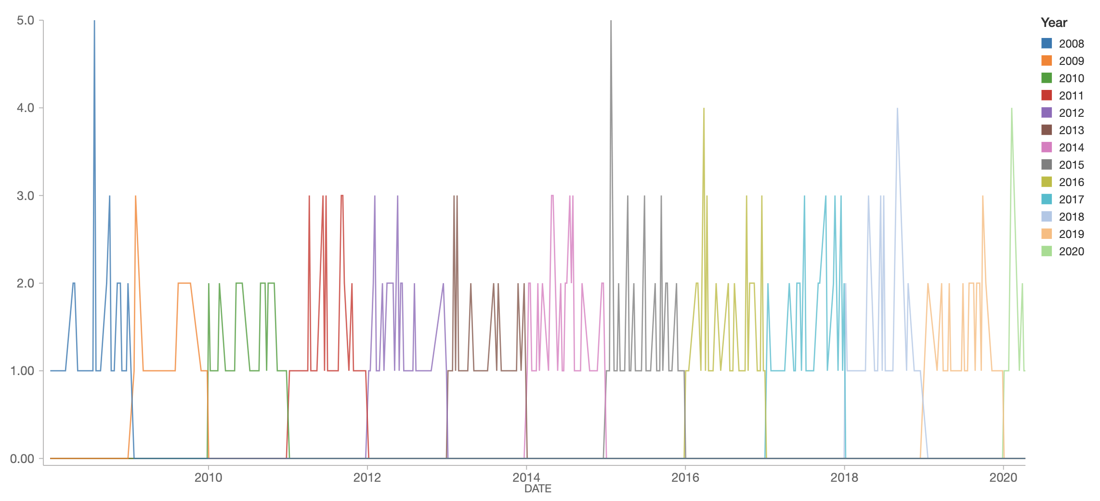
3 Downtown Crimes on Sunday
Regard the ‘Downtown Commercial’ District as the downtown
2008, 2015, 2016, and 2018 have more cases on Sundays.

Slide 12
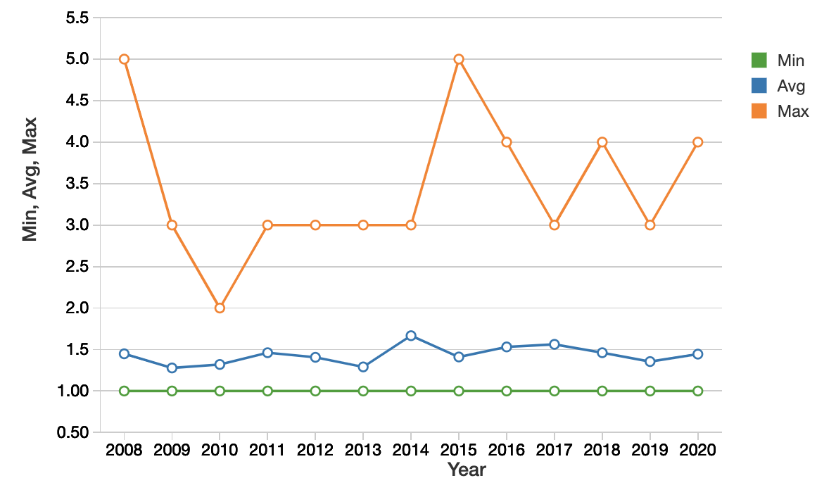
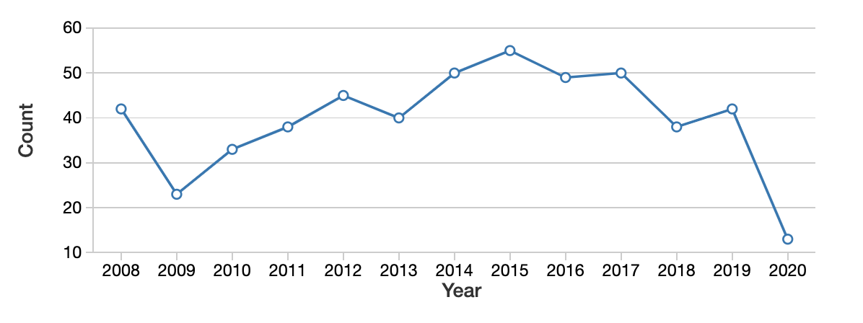
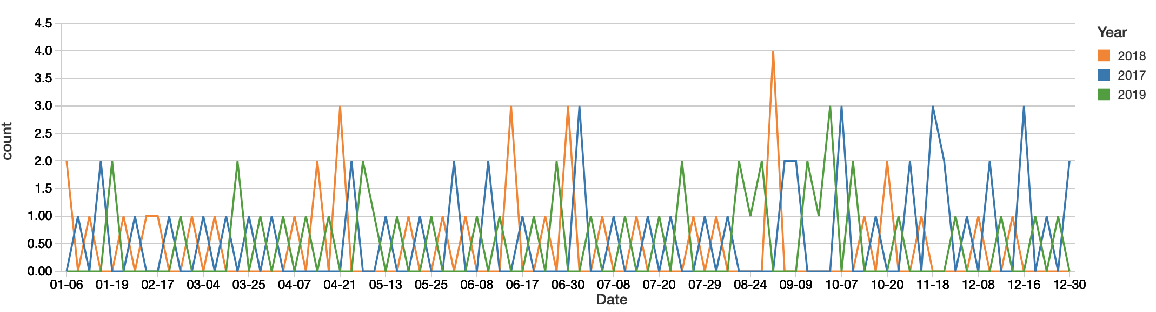
3 Downtown Crimes on Sunday
Min, Max, Avg crimes on Sundays
Total number of crimes on Sundays
Number of crimes on Sundays in 2017, 2018, 2019

Slide 13
3 Downtown Crimes on Sunday
Number of crimes on Sundays in 2017, 2018, 2019
The crime rate in the first half of the year was relatively stable
But there may be greater fluctuations in the second half (especially in the August to October)
In 2017, the November and December have relatively high crime cases.

Slide 14
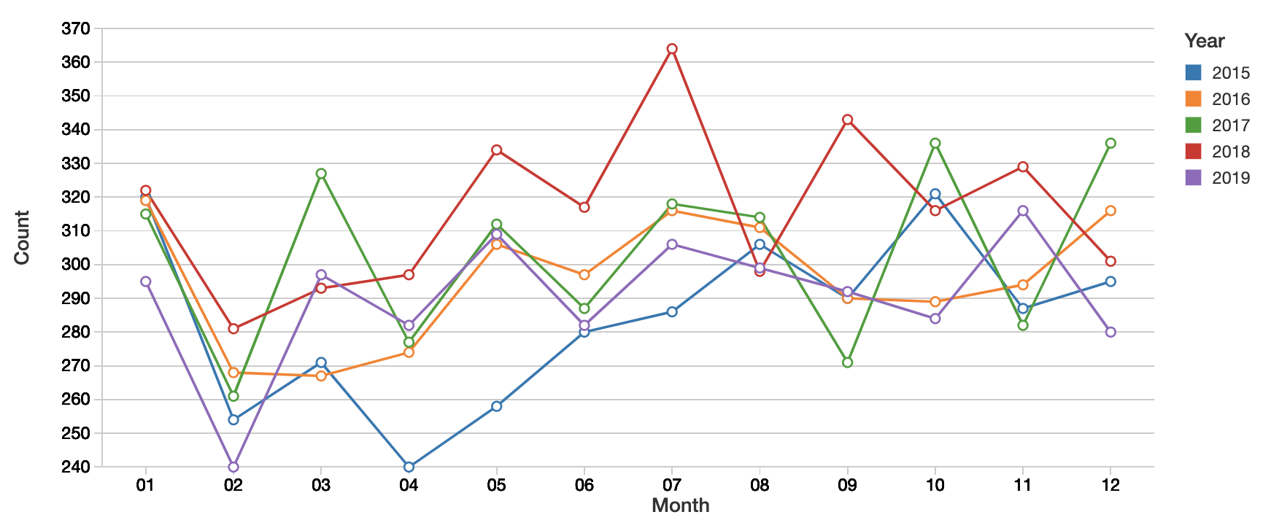
4 Monthly Crime
Monthly crimes 2015 - 2019
The overall crime rate in July was relatively high, especially in 2018
For 2018, July, May and September had higher crime rates
For 2017, the crime rate fluctuated greatly, which was lower in January, September and November, but suddenly increased in February, October and December.

Slide 15
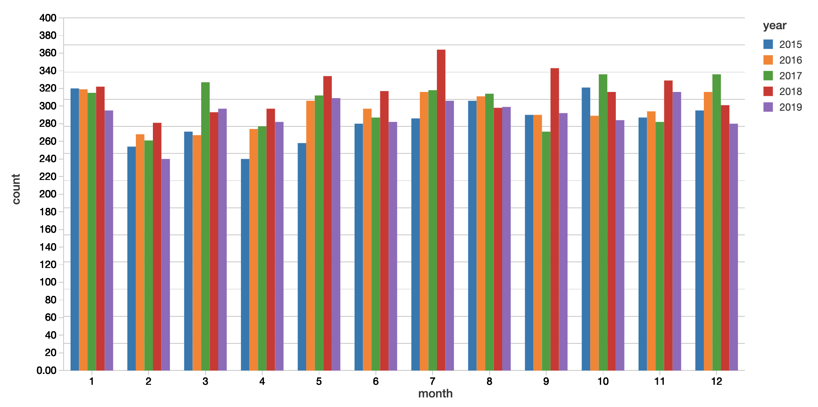
4 Monthly Crime
Monthly crimes 2015 - 2019
The fluctuation of the crime rate in the second half of the year is smaller than that in the first half.
In January and August, the crime rate in the same period in different years was not much different, but in other months it was quite different.

Slide 16
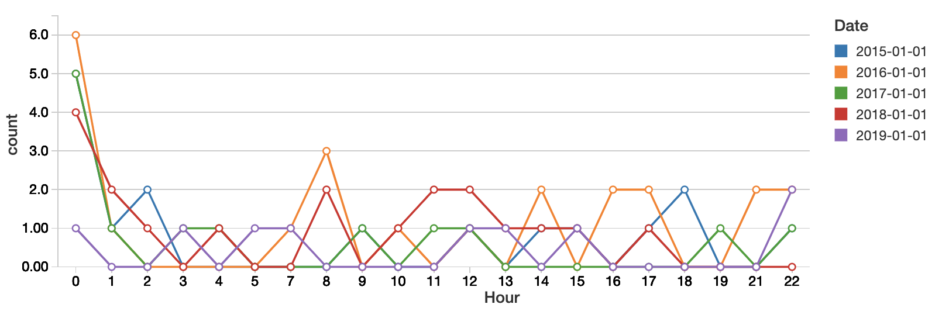
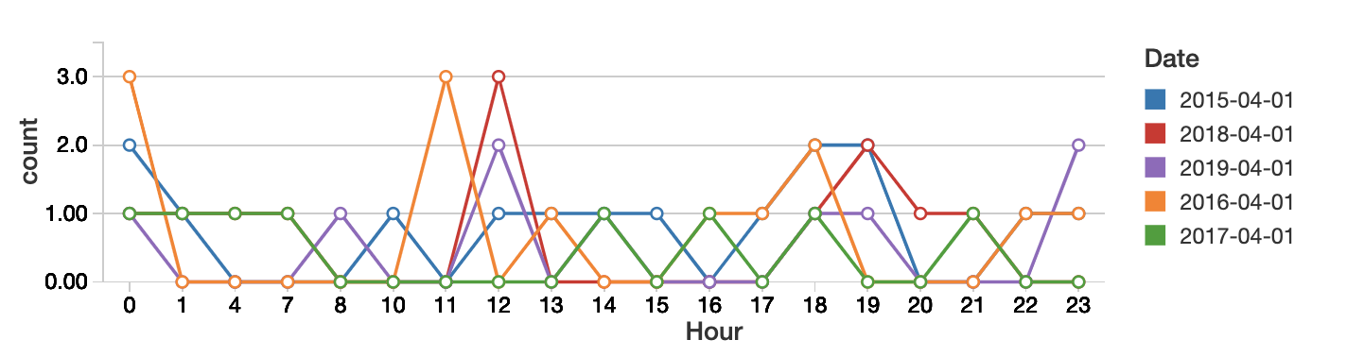
5 Hourly Crime - Jan 1st & April 1st

Slide 17
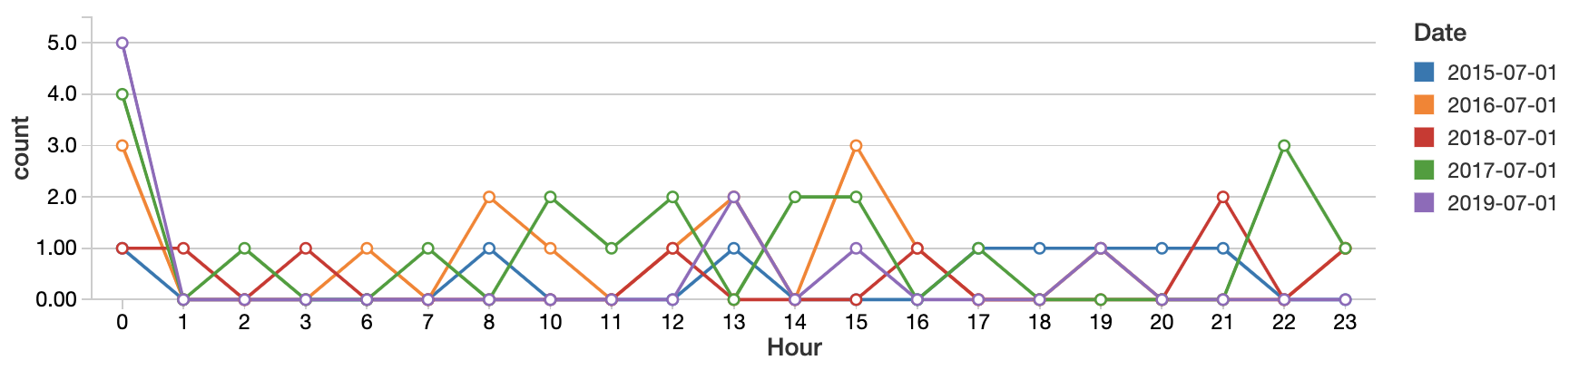
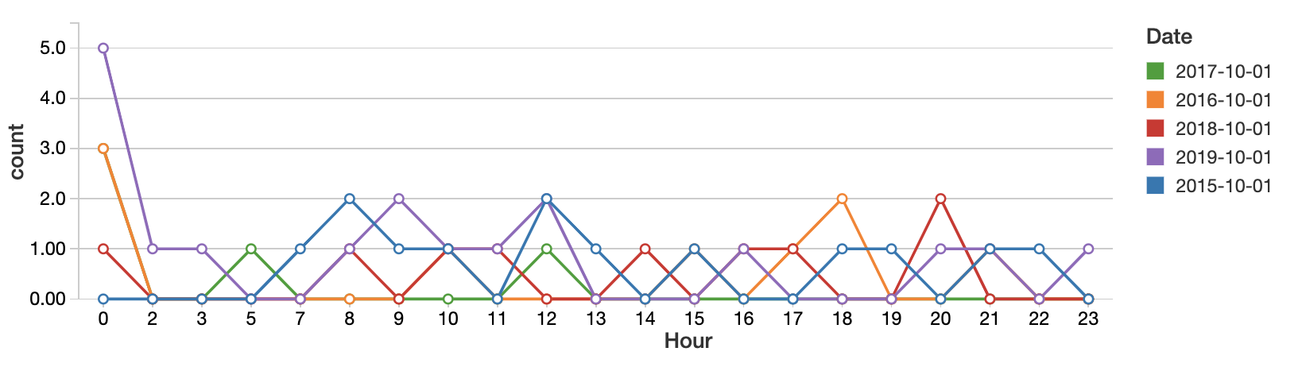
5 Hourly Crime - July 1st & October 1st

Slide 18
5 Hourly Crime
Findings
Midnight is when Seattle has the highest crime rate
Local theft cases are known to be the most, and property crimes including burglary and theft also frequently occur at midnight
Afternoons in July had higher crimes, high temperatures can easily cause higher crime rates
The average crime rate in April is less than that in January
Suggestions
Residents should avoid go out at midnight
Residents are advised to protect their property, such as locking doors and windows, and paying attention to anti-theft.

Slide 19
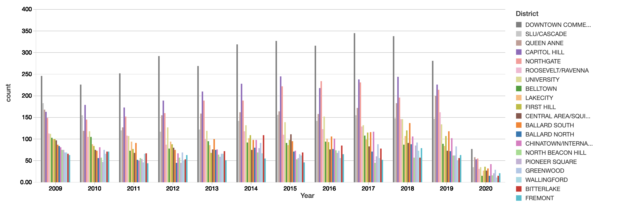
6 District vs. Time
- Three most dangerous areas
Define the areas with the highest annual crime cases as the most dangerous areas

Slide 20
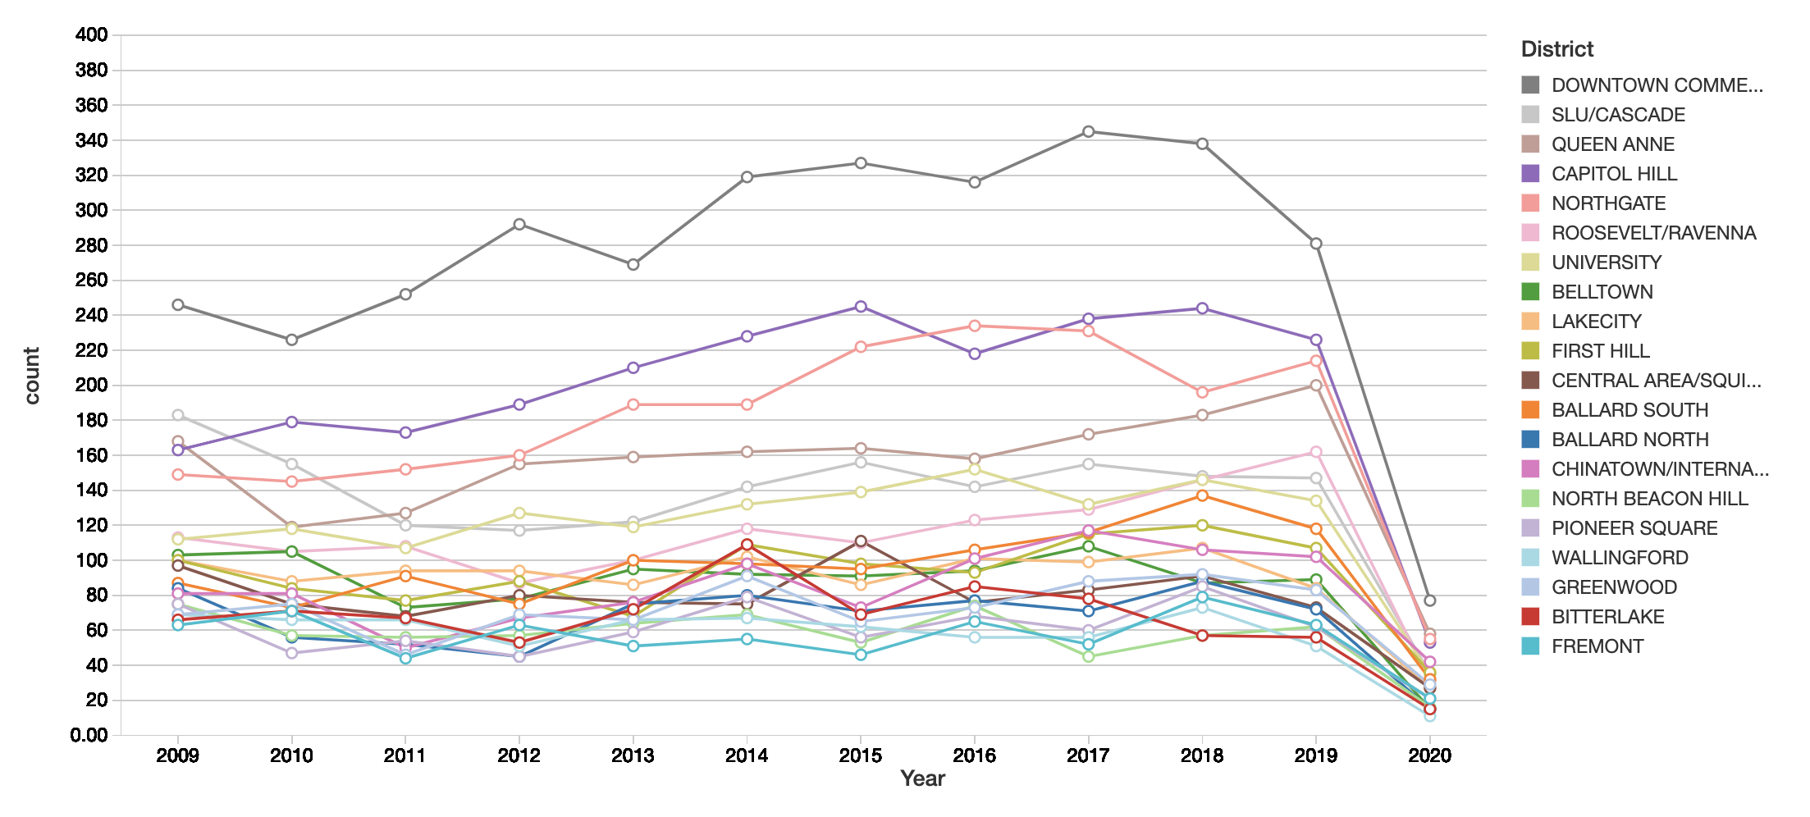
6 District vs. Time
Downtown Commercial with diverse population and business tends to provide opportunities for crimes.
In most years except for 2016, the crime cases in Capitol hill was larger than that of Northgate.
From 2008 to 2017, the overall crime rate showed an upward trend.
The number of crimes in downtown increased year by year. Since 2018, this number has declined.

Slide 21
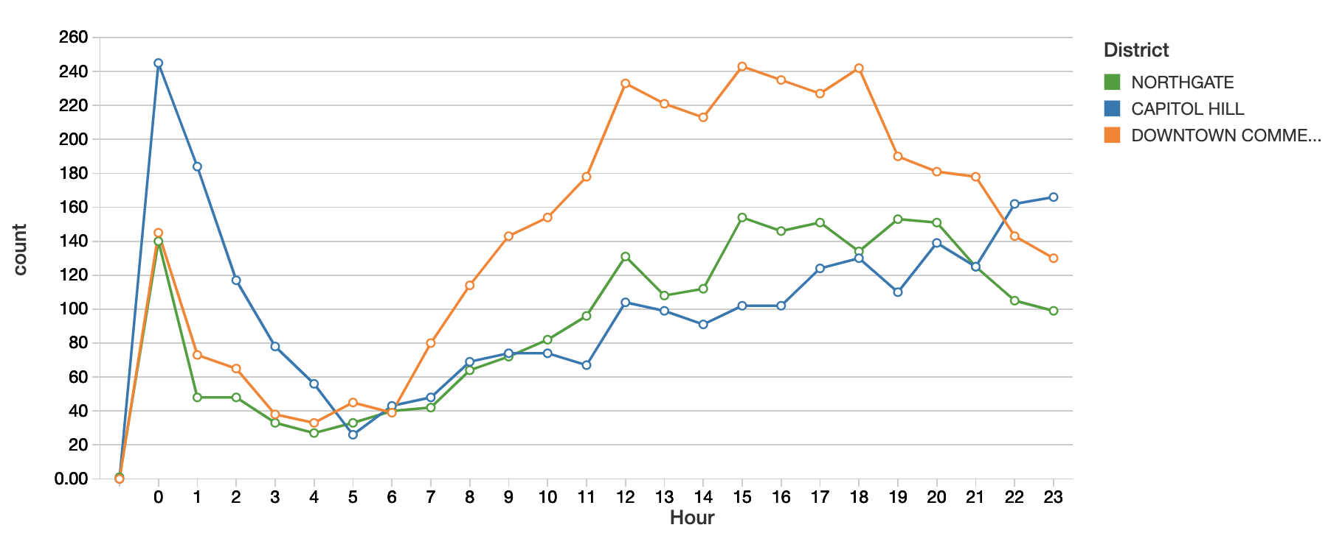
6 District vs. Time
Downtown Commercial: the crime rate continued to increase from 6 a.m. until it reached its peak around 12 p.m. and continued until about 6 p.m.
After 6 p.m., the crime rate has declined, possibly because people in the city center come home from work and the population density has dropped rapidly.

Slide 22
6 District vs. Time
For Capitol Hill and Northgate, the number of crimes has gradually increased from 5am without significant decline.
Capitol Hill is the seat of US government agencies with a very high crime rate at midnight.
Northgate is named after and surrounds the first Northgate Mall, so Northgate has a higher crime rate as a commercial center.

Slide 23
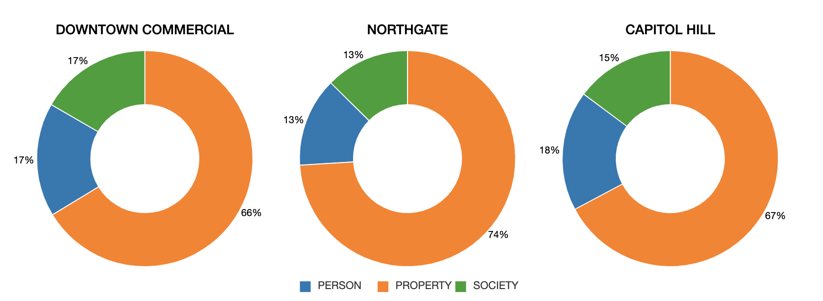
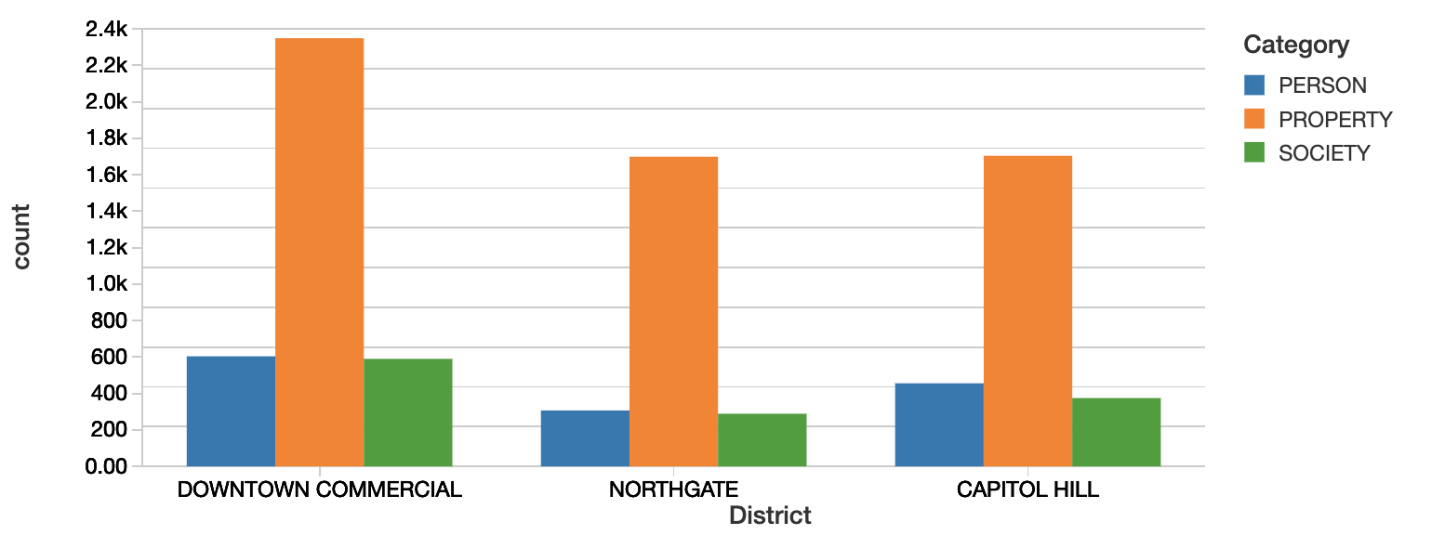
6 District vs. Category
Property crimes accounted for the largest share, with Northgate's property crime rate reaching 74%.
In Northgate and Downtown Commercial, the number of person and society crime cases are almost the same.

Slide 24
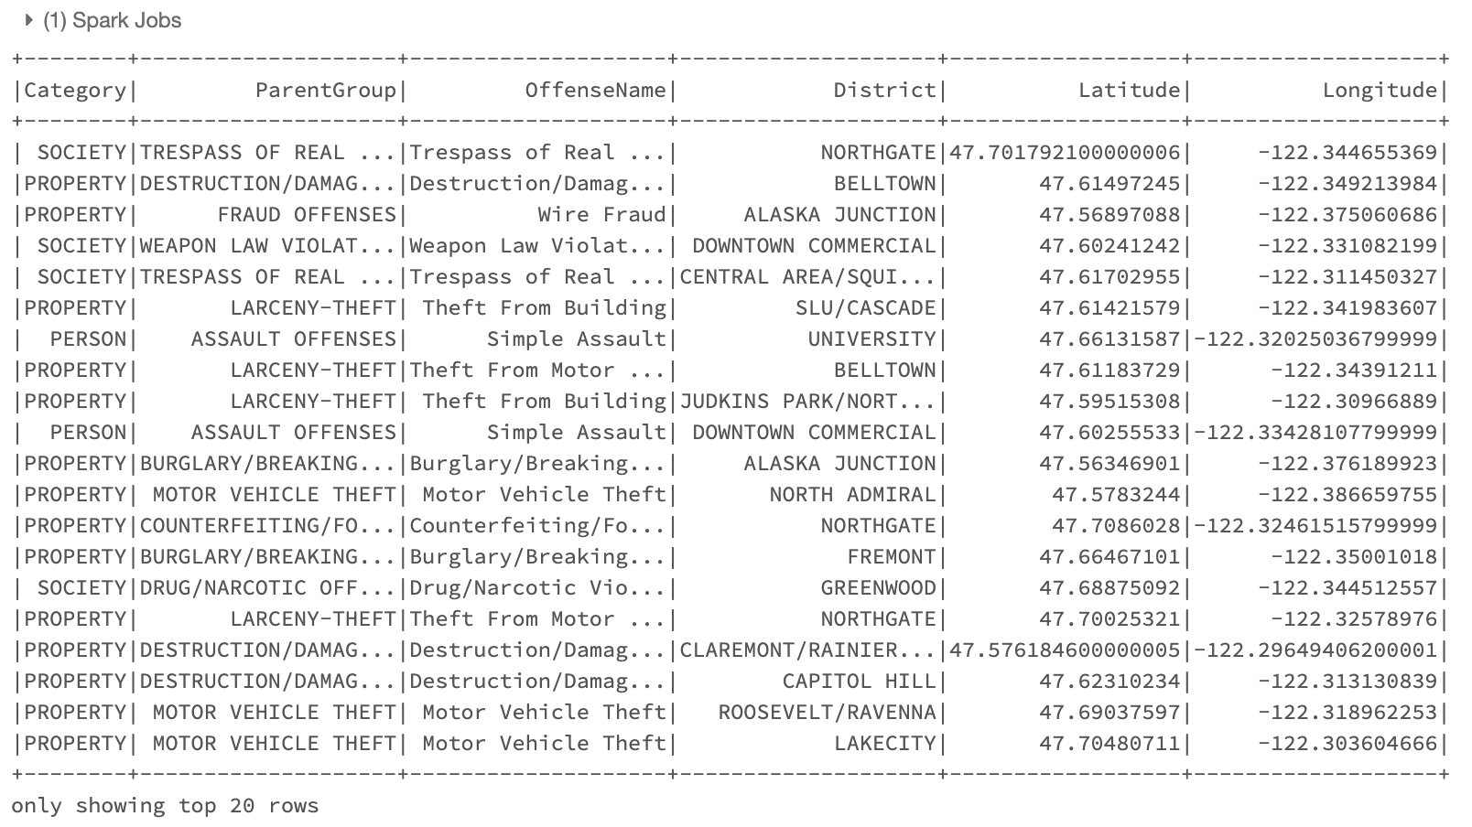
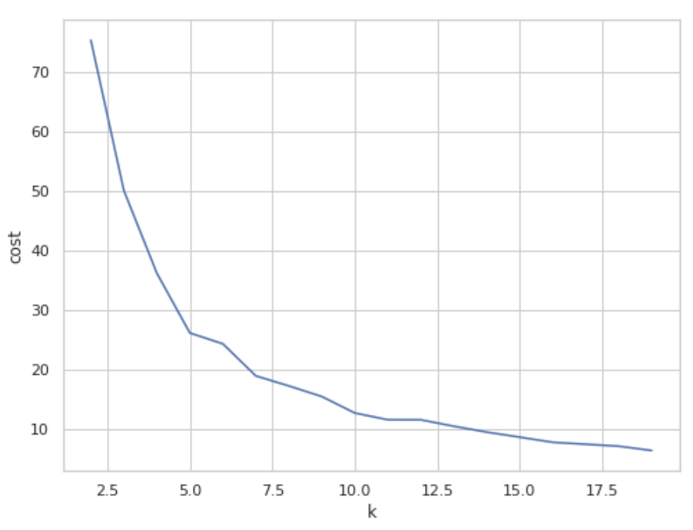
04 Unsupervised Learning – K Means
Apply Spark ML clustering algorithm to cluster the spatial data, then visualize the clustering results
Post computational costs of different Ks to choose optimal K, try K = 5, K = 7, K = 11
Subset the data and dropped outliers and null value

Slide 25
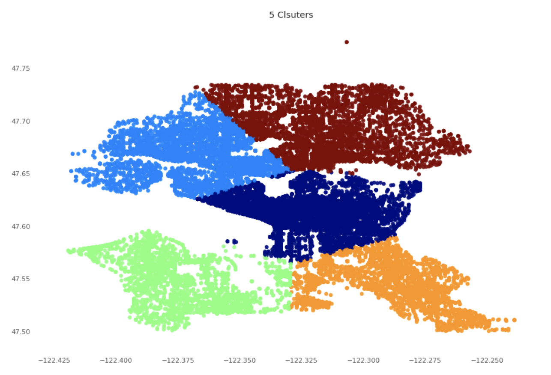
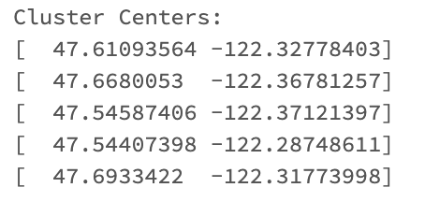
4-1 Unsupervised Learning – K = 5
When K = 5, the results of K Means model:
The cluster centers when K = 5
Silhouette with squared Euclidean distance = 0.676685081175843
Note: The silhouette value is a measure of how similar an object is to its own cluster (cohesion) compared to other clusters (separation). The silhouette ranges from −1 to +1, where a high value indicates that the object is well matched to its own cluster and poorly matched to neighboring clusters.

Slide 26
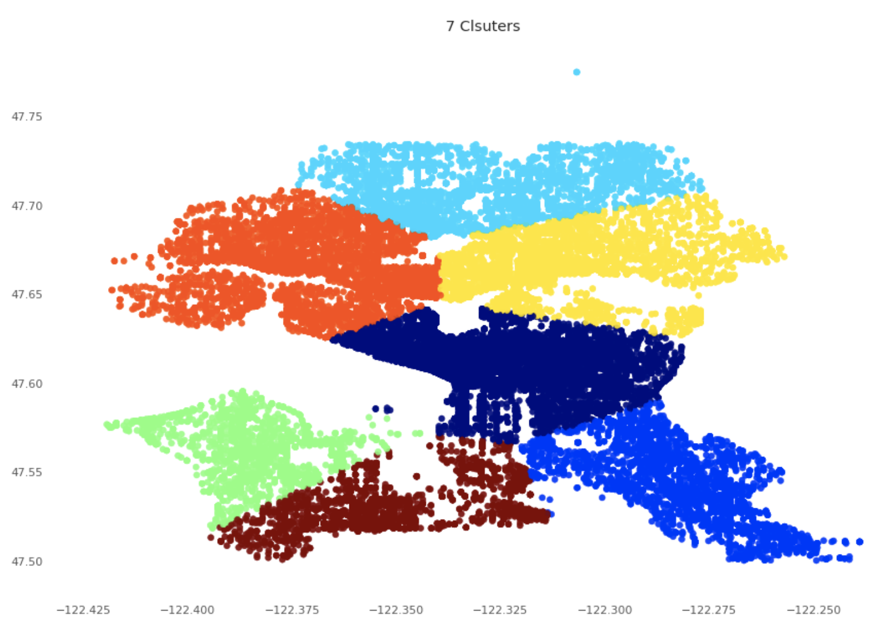
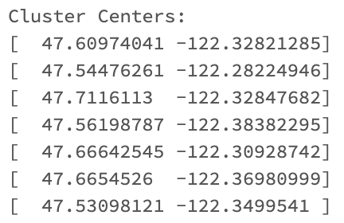
4-2 Unsupervised Learning – K = 7
When K = 7, the results of K Means model:
The cluster centers when K = 7
Silhouette with squared Euclidean distance = 0.6725548253058243

Slide 27
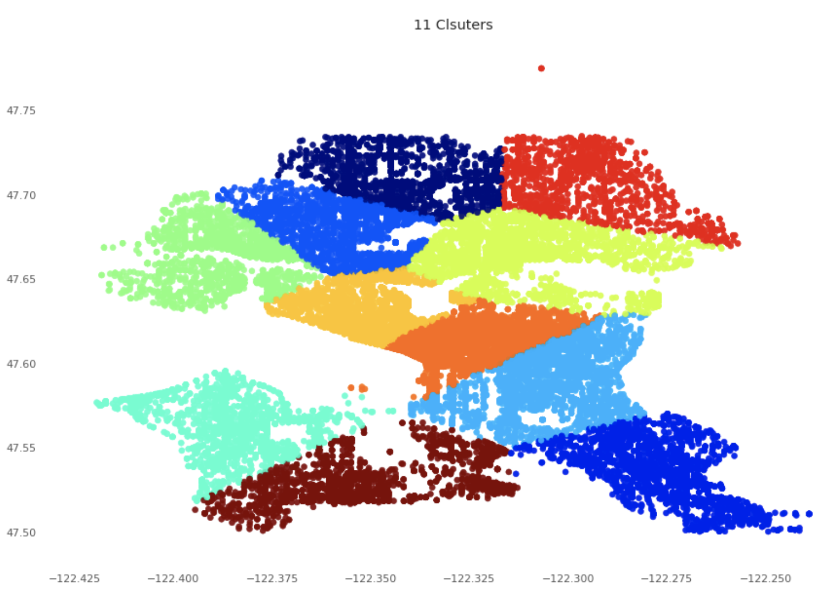
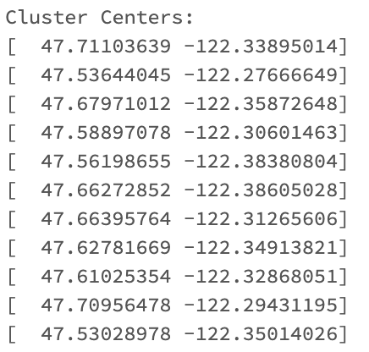
4-3 Unsupervised Learning – K = 11
When K = 11, the results of K Means model:
The cluster centers when K = 11
Silhouette with squared Euclidean distance = 0.5547070083978424

Slide 28
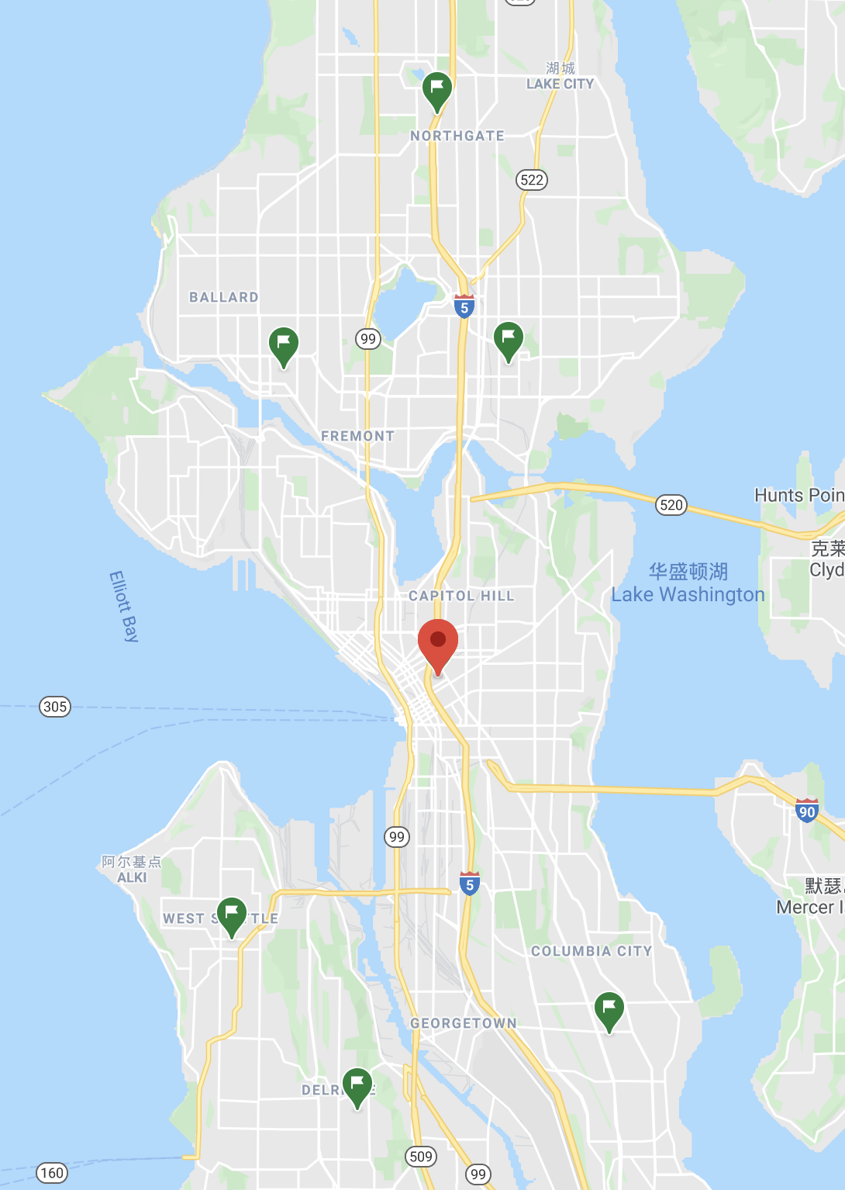
4-4 Clustering results vs Seattle map
Finally choose model with K = 7 for after tradeoff of Silhouette and complexity
Most dangerous area

Slide 29
Conclusion
Objective
Studied on the dataset of crime in Seattle from 2008 to 2020 in six aspects to seek crime patterns in Seattle and give recommendations for residents, visitor, and police on how to avoid crimes and stay safe.
Techniques
This process is conducted by Apache Spark, using multiple tools such as Spark SQL, Dataframe, OLAP, visualization, etc. after essential data sampling and processing.

Slide 30
Conclusion
Findings
The crime rate in the whole Seattle increased until 2017 and then tended to decline.
Among three main categories of crimes, the property crime accounted for 73.7%.
Among 30 parent groups of crimes, the larceny theft had the most cases.
Downtown commercial, Capitol Hill, and Northgate were the most dangerous areas.
Crime rates on Sundays were high in 2008 and 2015.
April had relatively low crime rate and July had relatively high crime rate.
Midnight was the most dangerous time.
Afternoons in summer tended to have higher crime cases.
Recommendations
Always pay attention to property safety, especially in the most dangerous areas.
try to minimize living or staying in these areas and avoid going out at midnight.
As crime rates tend to rise in a day, people should be more vigilant about crime in the afternoon.
The police force coverage should pay more attention to the three most dangerous regions, help tourists identify dangerous districts and hours to visit in Seattle.

Slide 31
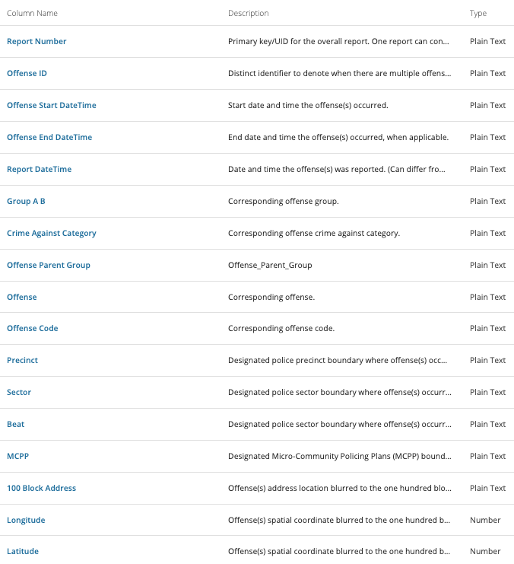
Appendix – Data Dictionary

Slide 32
References
Dataset: SPD Crime Data: 2008-Present
https://data.seattle.gov/Public-Safety/SPD-Crime-Data-2008-Present/tazs-3rd5
Jagannathan., M (2019) High temperatures can lead to more violent crime, study finds
https://nypost.com/2019/06/18/high-temperatures-can-lead-to-more-violent-crime-study-finds/

Slide 33
Thank You
For The Attention

